Slide 1
API PARADIGM

Slide 2
API (Application Programming Interface) is a set of rules and protocols that allows different software applications to communicate and interact with each other. It defines the methods and data formats that applications can use to request and exchange information or perform specific actions. APIs are essential in modern software development as they enable developers to build upon existing software and services, creating new applications or features without having to recreate everything from scratch.

Slide 3
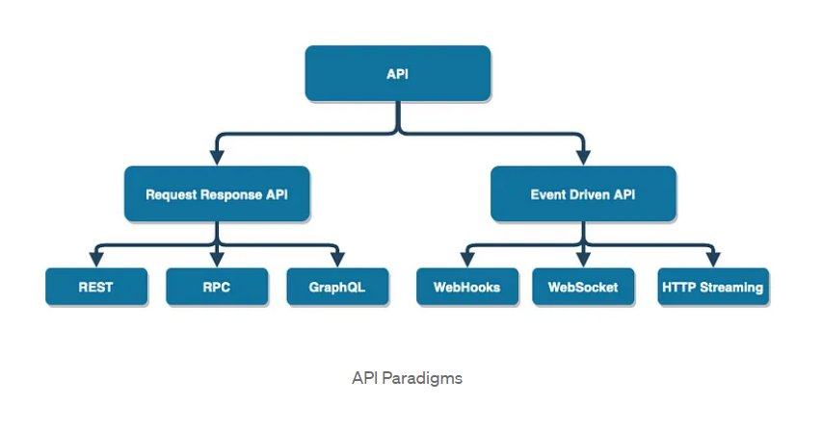

Slide 4
Key points about APIs!
Communication: APIs enable different software components or systems to communicate and share data. This communication can happen over the internet or within a single computer.
Abstraction: APIs provide an abstraction layer, hiding the internal complexities of the software or service being accessed. This allows developers to use the API without needing to understand the inner workings of the system.
Standardization: APIs are designed with specific standards and conventions, making it easier for developers to understand and use them. This standardization promotes interoperability.

Slide 5
Key points about APIs!
Functionality: APIs can offer various types of functionality. They can be used to retrieve data from a database, control hardware devices, interact with web services, or perform other operations.
HTTP APIs: Many modern APIs are built using HTTP (Hypertext Transfer Protocol) and are accessible over the internet. These are often referred to as "web APIs" and are commonly used for connecting web applications to external services or data sources.
REST and SOAP: Two common architectural styles for web APIs are Representational State Transfer (REST) and Simple Object Access Protocol (SOAP). REST APIs use HTTP methods (GET, POST, PUT, DELETE) to perform operations on resources, while SOAP uses XML-based messaging.

Slide 6
Key points about APIs!
Authentication and Authorization: APIs often require authentication to ensure that only authorized users or applications can access the data or perform actions. This can involve API keys, tokens, or other authentication mechanisms.
Rate Limiting: To prevent abuse and ensure fair usage, APIs often implement rate limiting, which restricts the number of requests a client can make within a specific time frame.
Documentation: Good API documentation is crucial to help developers understand how to use an API effectively. It provides details on endpoints, request and response formats, authentication, and usage examples.
Security: APIs must be designed with security in mind to protect against data breaches, unauthorized access, and other vulnerabilities.

Slide 7
REST API Representational State Transfer
REST API, or Representational State Transfer Application Programming Interface, is a type of web API (Application Programming Interface) that follows the principles and constraints of the REST architectural style. REST is not a protocol but a set of architectural constraints that guide the design of networked applications. These constraints help in creating scalable, stateless, and loosely coupled systems that can be easily maintained and extended. REST APIs are commonly used for building web services and are based on the HTTP protocol.

Slide 8
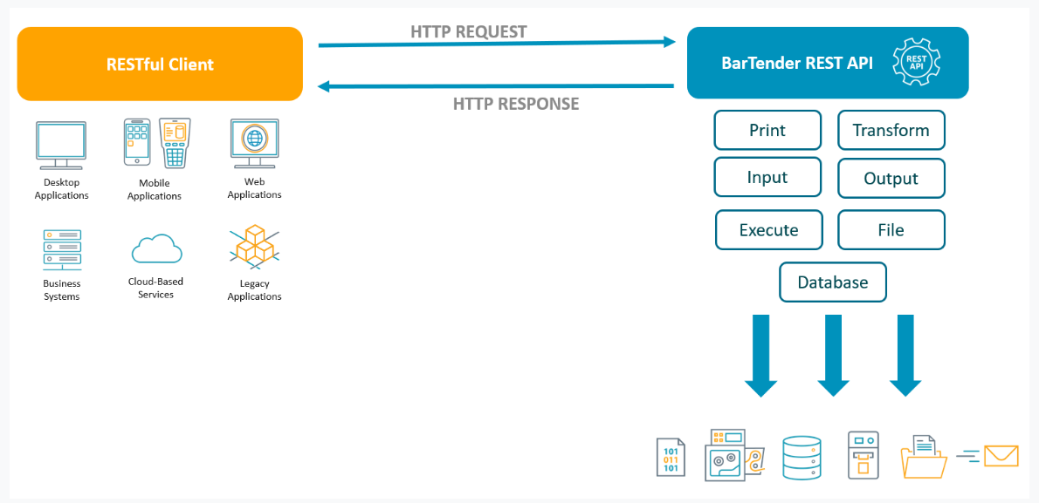

Slide 9
RPC Remote Procedure Call
RPC stands for Remote Procedure Call, which is a protocol that allows one program or process to request a service or function to be executed on another remote system as if it were a local function call. In essence, RPC enables distributed and networked applications to communicate by invoking procedures or methods on remote servers, as if they were local function calls. It abstracts the complexities of network communication, making it easier for developers to build distributed systems.

Slide 10
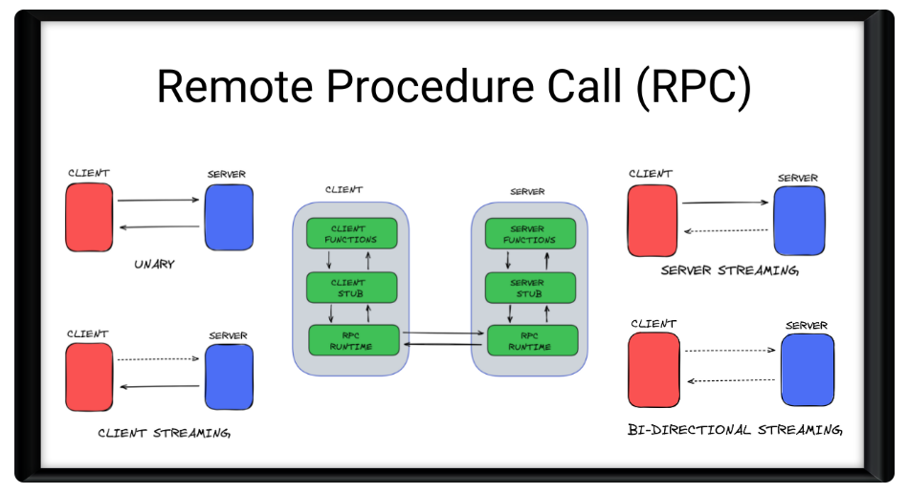

Slide 11
GraphQL
GraphQL is an open-source query language for APIs (Application Programming Interfaces) and a runtime environment for executing those queries by leveraging a type system you define for your data. It was developed by Facebook and released in 2015, and it has gained widespread adoption in the software development community since then.

Slide 12
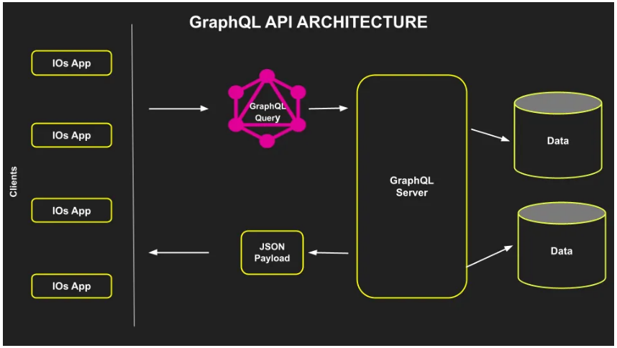

Slide 13
Here are some key characteristics and concepts related to GraphQL:
Flexible Querying: GraphQL allows clients to request exactly the data they need and nothing more. Clients can specify the structure of the response, including nested data, which reduces over-fetching (retrieving more data than needed) and under-fetching (not getting enough data) of information.
Strongly Typed: GraphQL APIs are strongly typed, meaning that you define the data types (object types, scalar types, etc.) and their relationships in a schema. This schema serves as a contract between the client and the server, providing a clear and self-documenting way to interact with the API.
Single Endpoint: Unlike traditional REST APIs that often have multiple endpoints for different resources, GraphQL typically has a single endpoint (e.g., /graphql) for all API requests. This simplifies the API structure and reduces the number of network requests.
Real-time Data: GraphQL supports real-time data updates using technologies like WebSockets. This enables developers to build interactive and live-updating applications, such as chat apps and dashboards.

Slide 14
Webhook
A Webhook is a mechanism that allows one application or system to notify or send data to another application or system in real-time when a specific event or trigger occurs. Webhooks are commonly used in software development and integration to automate processes and enable seamless communication between different services.

Slide 15
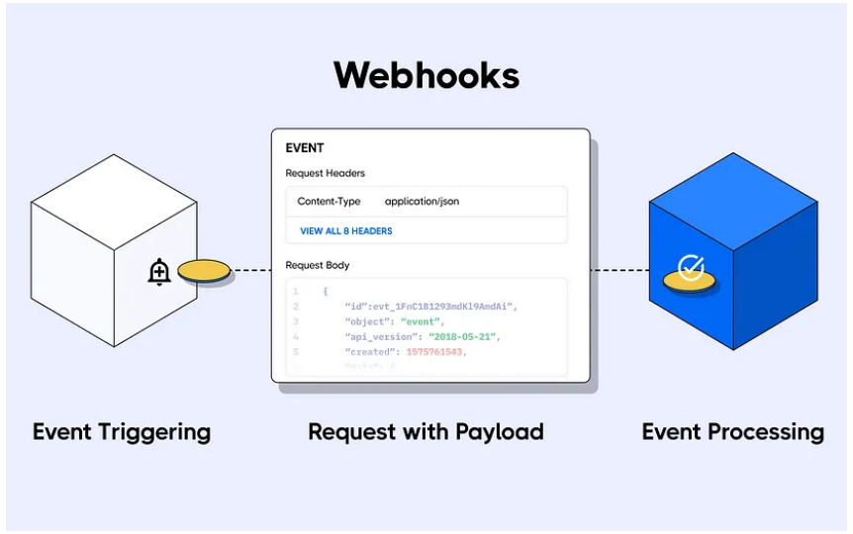

Slide 16
Here's how Webhooks typically work:
Event Occurs: In the source application or system (the one generating events), a specific event or trigger takes place. This event could be a new user registration, a payment confirmation, a status update, or any other action that you want to monitor or respond to.
Webhook Configuration: The source application provides a URL endpoint (usually an HTTP or HTTPS URL) where it will send data when the event occurs. This URL is often referred to as the webhook URL or callback URL.
Data Payload: When the event occurs, the source application assembles a data payload that contains relevant information about the event. This data is typically formatted in a specific way, such as JSON or XML, and may include event details, user information, or any other relevant data.
HTTP POST Request: The source application sends an HTTP POST request to the webhook URL, including the data payload as the request body. This request is made to the server hosting the target application or service.
Processing at Target: The target application or service receives the HTTP POST request and processes the data payload. This could involve performing actions based on the received data, updating databases, triggering notifications, or any other desired operation.

Slide 17
WebSocket
WebSocket is a communication protocol that provides full-duplex, bidirectional communication channels over a single, long-lived connection. It is designed to work over the same ports as HTTP and HTTPS (ports 80 and 443, respectively) and is often used to enable real-time, interactive communication between a web browser and a web server. WebSocket is particularly well-suited for applications that require low latency and high interactivity, such as chat applications, online gaming, live data feeds, and collaborative tools.

Slide 18
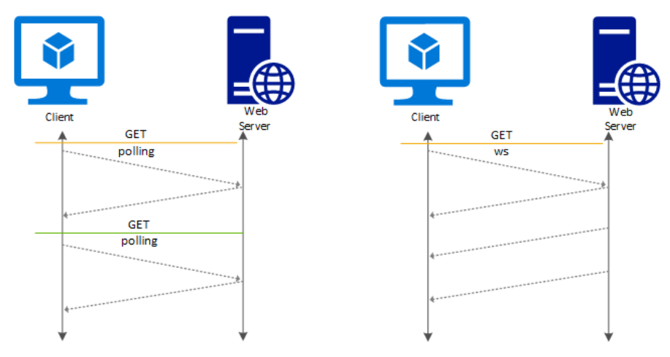

Slide 19
Key features and characteristics of WebSocket:
Full-Duplex Communication: Unlike traditional HTTP, which follows a request-response model where the client sends a request and the server sends a response, WebSocket allows for simultaneous two-way communication. Both the client and the server can send messages independently without waiting for a request or response.
Low Latency: WebSocket connections are long-lived, meaning they remain open after the initial handshake, reducing the overhead of repeatedly establishing new connections. This results in lower latency and faster communication compared to HTTP.
Efficient: WebSocket is efficient in terms of network and server resources because it eliminates the need for constant polling or frequent requests. The connection remains open, and data can be sent as soon as it's available.
Simple Protocol: WebSocket is a simple and lightweight protocol. It starts with an initial handshake (based on HTTP) to establish the connection, and once connected, messages can be sent as binary or text data.

Slide 20
Key features and characteristics of WebSocket:
Cross-Domain Communication: WebSocket allows for cross-origin communication, meaning a web page served from one domain can establish WebSocket connections to a server on a different domain. This is achieved through the WebSocket protocol's handshake mechanism.
Security: WebSocket connections can be secured using the same mechanisms as HTTP, such as SSL/TLS encryption (wss://), to ensure data privacy and integrity during transmission.
Subprotocols: WebSocket supports subprotocols, which are additional protocols built on top of WebSocket that can define specific message formats or behaviors. Examples of subprotocols include MQTT over WebSocket and STOMP over WebSocket.
Event-Driven: WebSocket is event-driven, meaning that applications can define how to handle incoming messages and events, making it well-suited for real-time applications.

Slide 21
HTTP Streaming
HTTP streaming, often referred to as HTTP-based streaming, is a method of delivering multimedia content, such as audio or video, over the Hypertext Transfer Protocol (HTTP). It allows the content to be delivered continuously and played in real-time as it's received by the client, rather than waiting for the entire file to download before playback begins. HTTP streaming is a fundamental technology for delivering live and on-demand multimedia content over the internet.

Slide 22
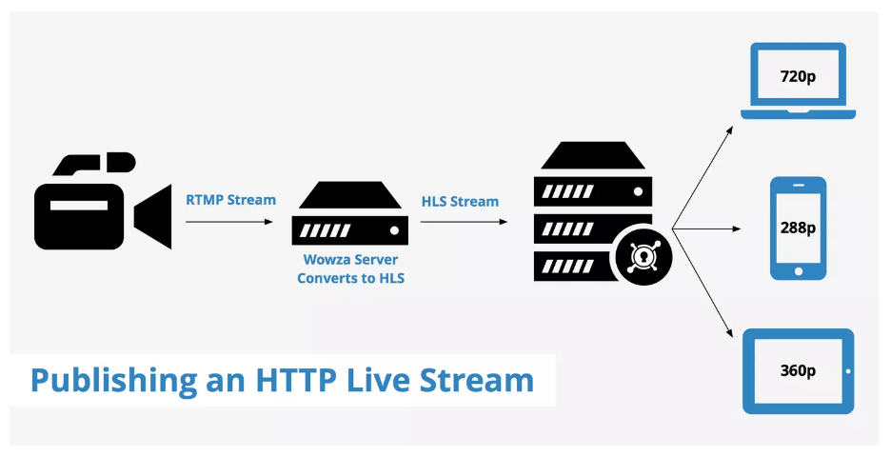

Slide 23
There are several key approaches to HTTP streaming:
1. HTTP Live Streaming (HLS):
HLS is a streaming protocol developed by Apple. It segments multimedia content into small, discrete chunks (typically 10 seconds) and serves these segments via standard HTTP web servers.
The client (e.g., a web browser or mobile app) periodically requests and downloads these segments and plays them in sequence. It allows adaptive streaming, meaning the client can switch between different quality levels based on available network bandwidth and device capabilities.
HLS is widely used for live streaming and video-on-demand services, and it's supported on various platforms, including iOS devices, web browsers, and Android with the help of third-party players.

Slide 24
There are several key approaches to HTTP streaming:
2. Dynamic Adaptive Streaming over HTTP (DASH):
DASH is an open standard developed by the Moving Picture Experts Group (MPEG). It works similarly to HLS but is designed to be more flexible and codec-agnostic.
DASH divides the content into small segments and offers multiple quality levels. It allows the client to adaptively switch between these levels based on network conditions.
DASH is supported by various media players and streaming services, making it a versatile option for HTTP streaming.

Slide 25
There are several key approaches to HTTP streaming:
3. Smooth Streaming (Microsoft):
Smooth Streaming is Microsoft's HTTP-based streaming protocol. It also segments content into small chunks, and clients can request different quality levels.
It's commonly used for streaming video content in Microsoft's ecosystem, including Silverlight applications and Azure Media Services.
4. MPEG-DASH (ISO/IEC 23009-1):
MPEG-DASH is an international standard for adaptive streaming over HTTP. It aims to standardize the adaptive streaming experience across different devices and platforms.
Similar to HLS and DASH, MPEG-DASH divides content into segments and provides various quality levels for adaptive streaming.

